Slide 1
International Agreements

Slide 2
Defining International Treaties
A treaty is an international written agreement between nation states.
Governed by international law, treaties contain mutual understandings and intentions that help guide how nations relate to each other.

Slide 3
The Importance of International Treaties
Is Australia a ‘Powerful” nation?

Slide 4
The Importance of International Treaties
With increased globalization, international treaties are becoming important - and important for Australia.

Slide 5
The Importance of International Treaties
Australia is considered a “Middle Power” – it does not carry the weight of larger countries such as the US and China.

Slide 6
The Importance of International Treaties
Negotiating international treaties allows Australia to have an international voice and prevent economic or strategic isolation.

Slide 7
Impact of International Treaties
When a nation signs an international treaty or convention, it is an expression of its political sovereignty. (ability to make its own decisions).
Act of signing a treaty does not make it legally binding.

Slide 8
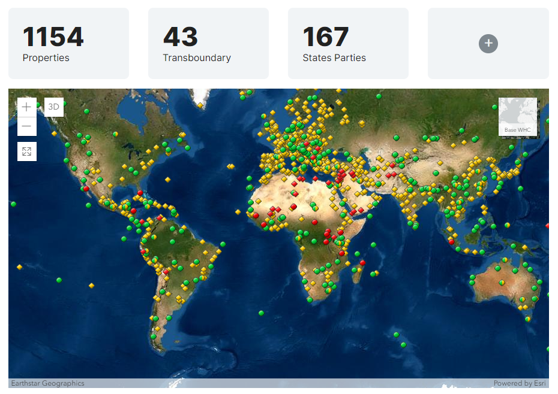
https://whc.unesco.org/en/list/
Notes:
https://whc.unesco.org/en/list/

Slide 9
World Heritage Sites
Instructions: Choose 2 World Heritage sites from around the world that you find interesting then answer the following questions on a PowerPoint. 1 is enough at this stage!
Where is the World Heritage site located? Find it on a world map.
Is it a natural, cultural or mixed site?
Why is the site significant?
Are there any threats to the site?
How is the site being protected?
https://whc.unesco.org/en/list/
If you have finished AND submitted – have a go at the treasure hunt – link is on Connect
If you have completed the treasure hunt, Google Search “World Heritage Convention” and read about the background while you wait ☺

Slide 10
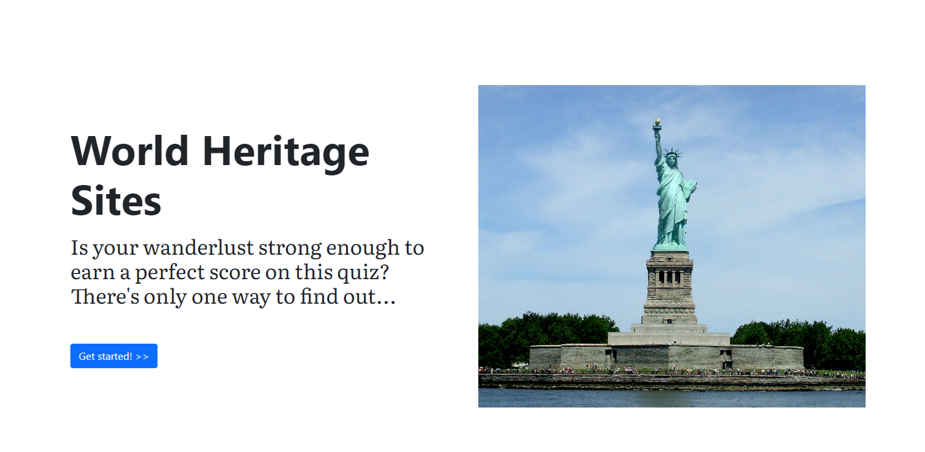
https://esri.github.io/treasure-hunt-app/?edition=heritage-sites
Notes:
https://esri.github.io/treasure-hunt-app/?edition=heritage-sites

Slide 11
What is Heritage?
Notes:
https://www.youtube.com/watch?v=lOzxUVCCSug
https://www.nationalgeographic.com/travel/world-heritage/about/#close

Slide 12
Heritage is the full range of our inherited traditions, monuments, objects, and culture.

Slide 13
A Major Treaty Signed by Australia

Slide 14
What is the World Heritage Convention?
The Convention defines the kind of natural or cultural sites which can be considered for inscription on the World Heritage List.
The Convention sets out the duties of States Parties in identifying potential sites and their role in protecting and preserving them.
By signing the Convention, each country pledges to conserve not only the World Heritage sites situated on its territory, but also to protect its national heritage.

